Slide 1
AI IN FINANCIAL SERVICES
DEFECT DETECTION FOR LAPTOPS
Industry Mentor
Manu Sharma
Hewlett Packard Enterprise(HPE)
Gayathri R 22i218
Vinithaa P 22z273
Kiruthika Sermadurai 22z336
Sanjitha R 22z259
Durga G 22z321
Academic Mentor
Dr.Suriya S
CSE Department
PSG College of Technology

Slide 2
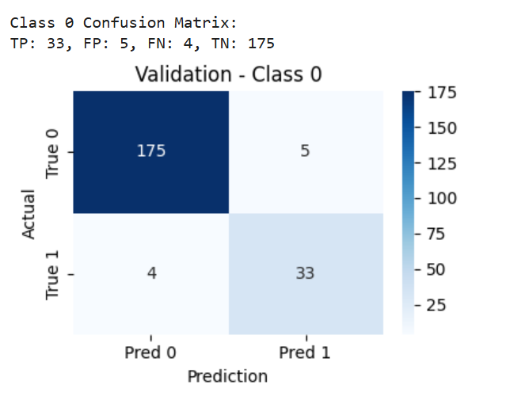
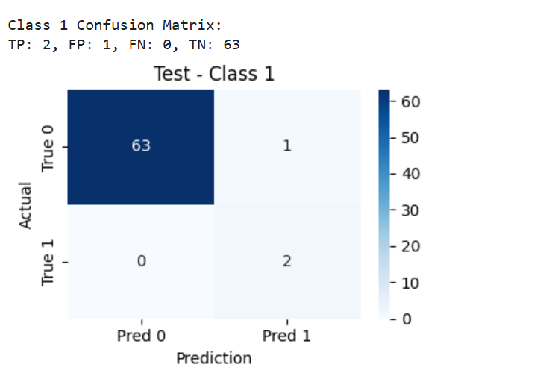
MobileNetV2 Multi-label

Slide 3
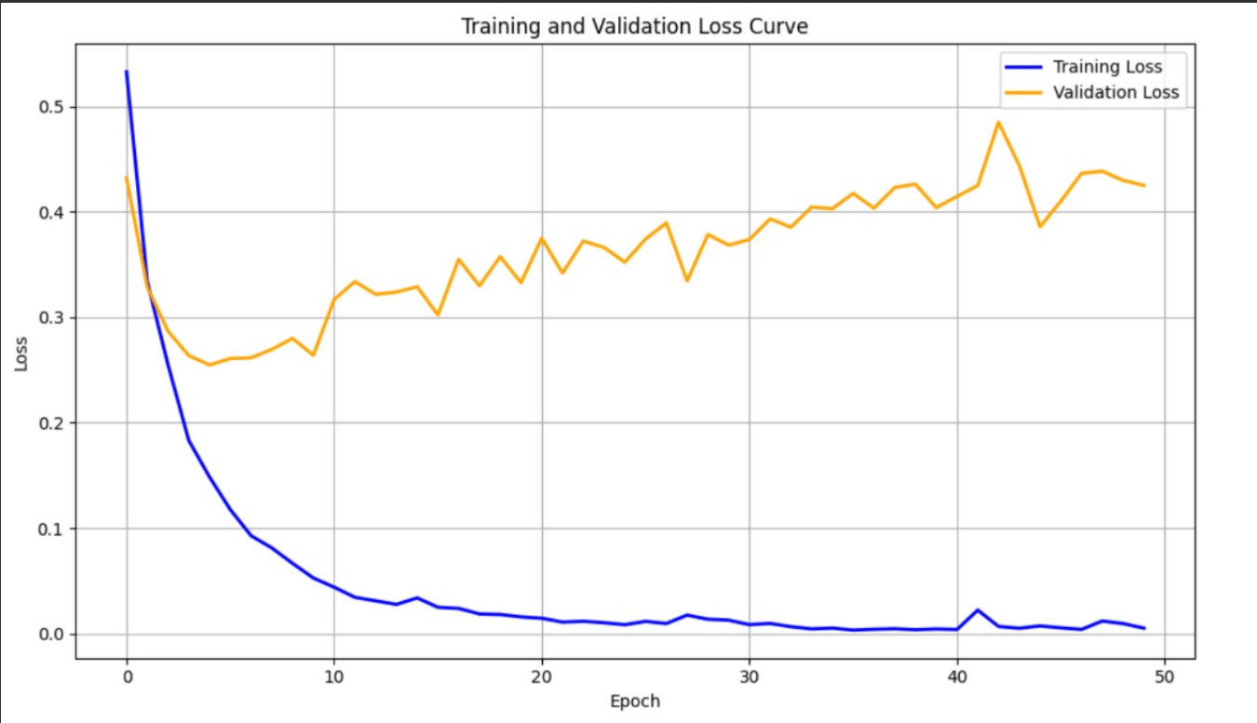
MobileNetV2 Multi-label

Slide 4
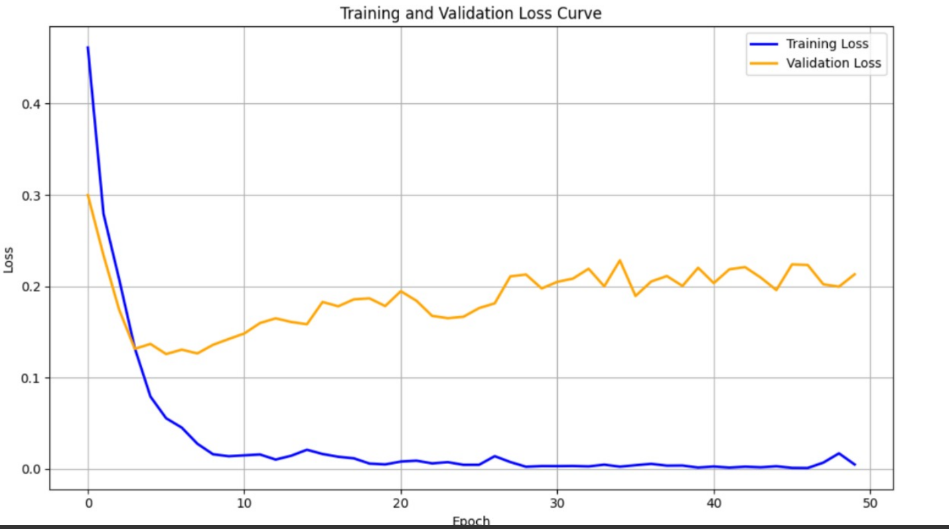
After removing spot and fade classes

Slide 5
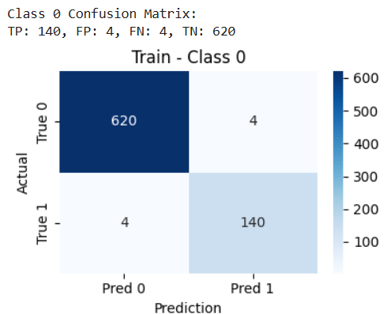
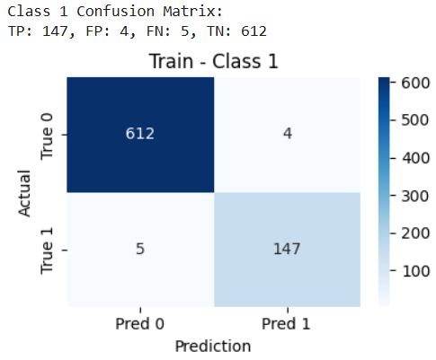
Resnet50 Multi-Labels

Slide 6
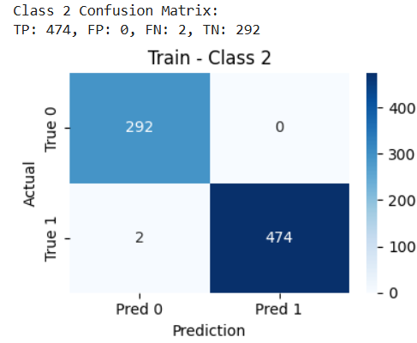
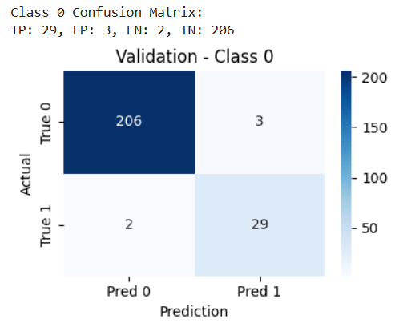
Resnet50 Multi-Labels

Slide 7
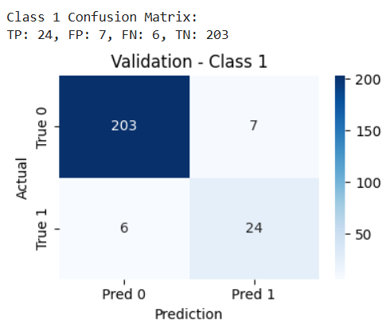
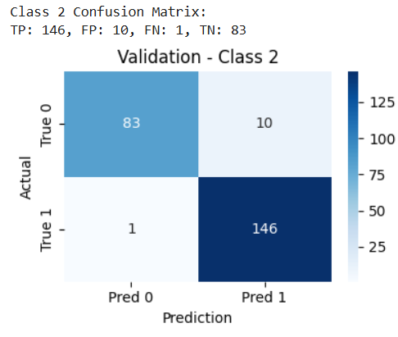
Resnet50 Multi-Labels

Slide 8
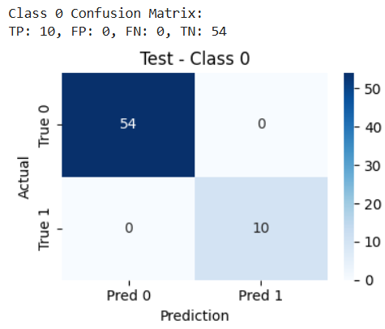
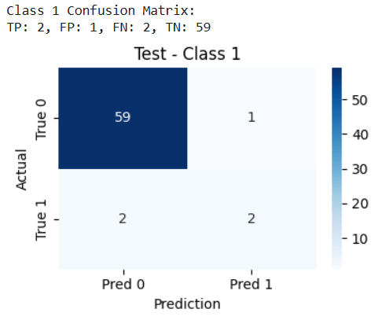
Resnet50 Multi-Labels

Slide 9
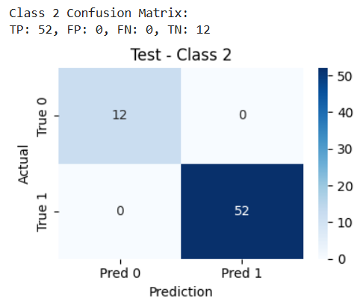
Resnet50 Multi-Labels

Slide 10
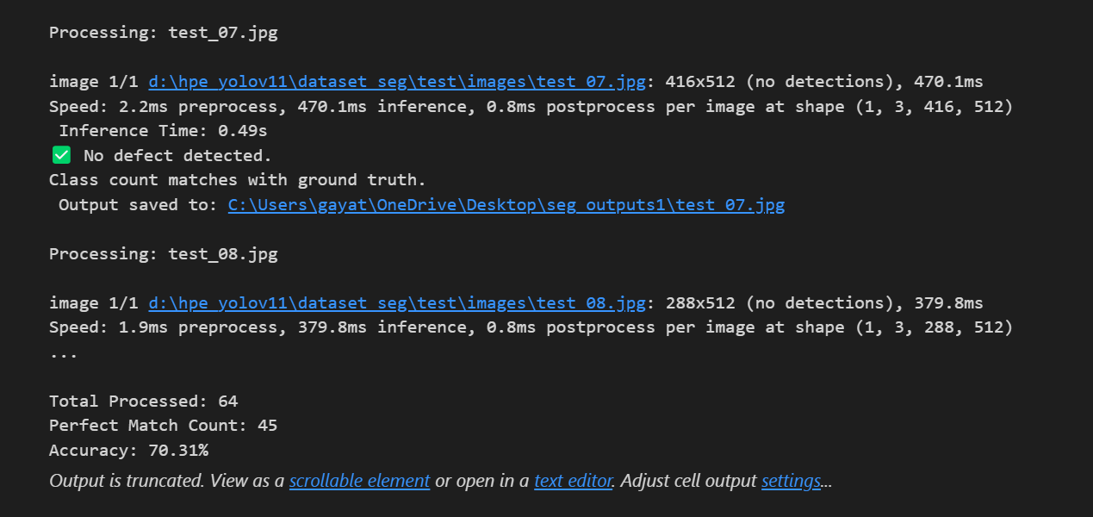
Yolov8- Accuracy score

Slide 11
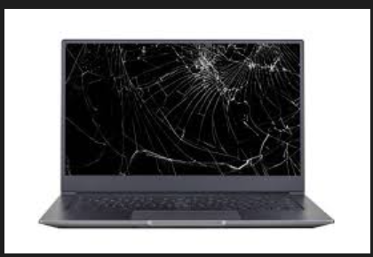
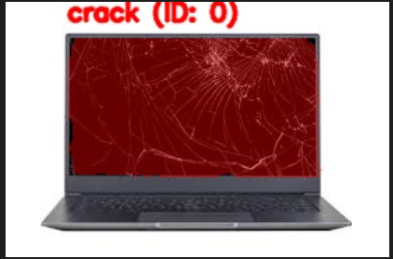
Yolov8- Defective laptops

Slide 12
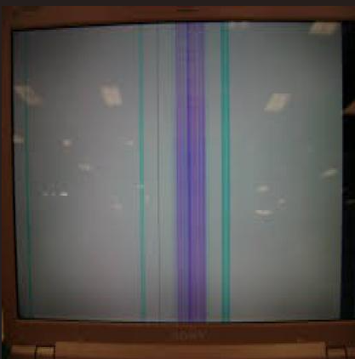
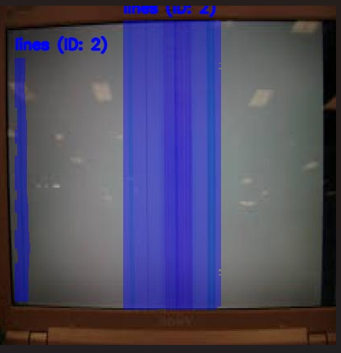
Yolov8- Defective laptops

Slide 13
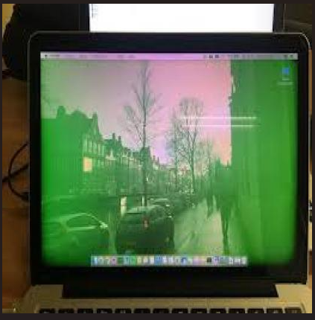
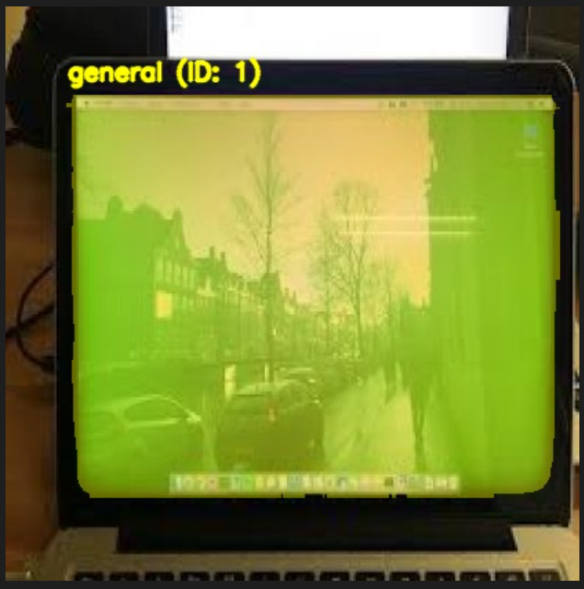
Yolov8- Defective laptops

Slide 14
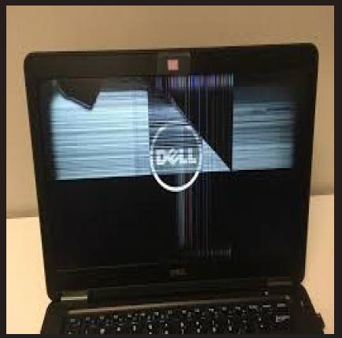
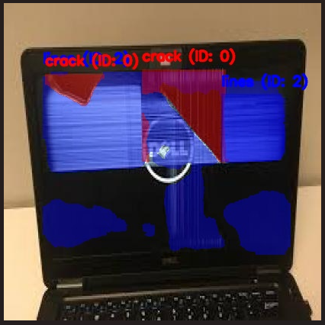
Yolov8- Defective laptops

Slide 15
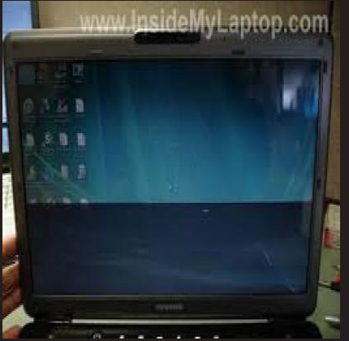
Yolov8- Defective laptops

Slide 16
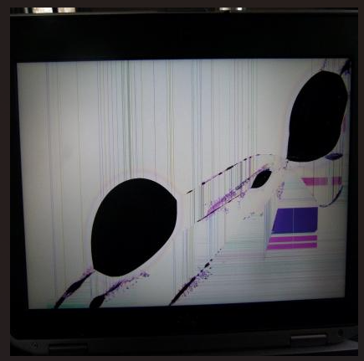
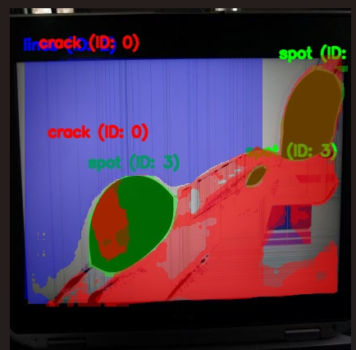
Yolov8- Defective laptops

